Slide 1
Chava Rosenfarb & Simkha Bunim Shayevitch Lodz Ghetto
Spring Course Paideia 2024

Slide 2
Simkha-Bunim Shayevitch: Poet of the Lodz Ghetto
Shayevitch was my mentor and friend. Through all the post-war years, his spirit has seemed to hover over me, a powerful presence in my own life as a writer. His poetic voice permeates my own poems and prose writings on the subject of the war. He himself, under a host of disguises, appears as a character in many of my stories. Even when I write on themes other than the Holocaust, he is somehow there with me, guiding me, forcing me to see present- day life through the prism of those earlier shattering experiences.

Slide 3
Simcha Bunim Shayevich and Chava Rosenfarb
Poem by Simcha Bunim:
And now, Blimele, dear child,
Lok outside, how the second group
Is already wandering into Exile.
Soon we'll have to set out, too (…)
Lekh – Lekho
Poem as a response to first deportation from Lodz ghetto: 16-29, 1942
Title, Genesis 12.1
וַיֹּ֤אמֶר יְהֹוָה֙ אֶל־אַבְרָ֔ם לֶךְ־לְךָ֛ מֵאַרְצְךָ֥ וּמִמּֽוֹלַדְתְּךָ֖ וּמִבֵּ֣ית אָבִ֑יךָ אֶל־הָאָ֖רֶץ אֲשֶׁ֥ר אַרְאֶֽךּ

Slide 4
Chava Rosenfarb: Yesterday I perrished….
Composed just before the liquidation of the Lodz ghetto, August 1944.
Last Lullaby:
Yesterday I perished and did not give birth to you, child.
My last day faded with the shadows,
your first day never saw the light.
Yesterday I perished like a mote in the eye of the sun;
while you have not yet in the sunrise
unfurled your blossoming crown.
(…)

Slide 5
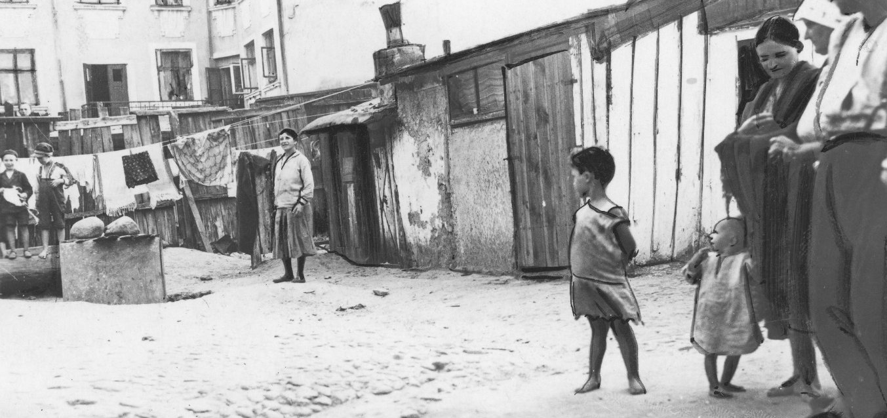
לאָדזש Łódź

Slide 9
Aus Lodz wird Liztmannstadt (1942) German propaganda documentary

Slide 10
Litzmannstadt Ghetto, 1942

Slide 11
Litzmannstadt Ghetto, 1942

Slide 12
Hans Biebow, the Chief of the Nazi administration of the Liztmannstadt Ghetto, 1942
Chaim Rumkowsky, the head of the Jewish Council of Elders in the Litzmannstadt Ghetto, 1942

Slide 13
Henryk Ross' photo of the Lodz Ghetto prison at Czarnecki Street, a rallying point before deportation, c. 1942. Museum of Fine Arts, Boston)

Slide 14
Liztmannstadt Ghetto after the liquidation in June – August 1944

Slide 16
The murals of Bałuty/ Children of Bałuty project

Slide 17
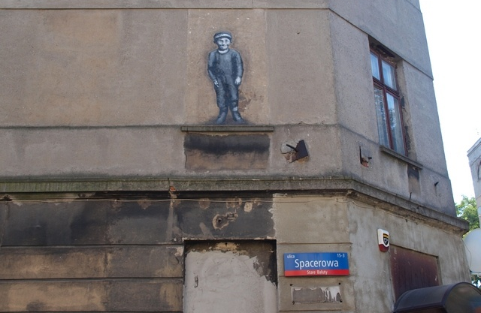

Slide 18
Radegast Station Museum

Slide 19
Litzmannstadt Ghetto Model in Radegast Station Museum

Slide 21
TheMarek Edelman Center for Dialogue in Łódź

Slide 22
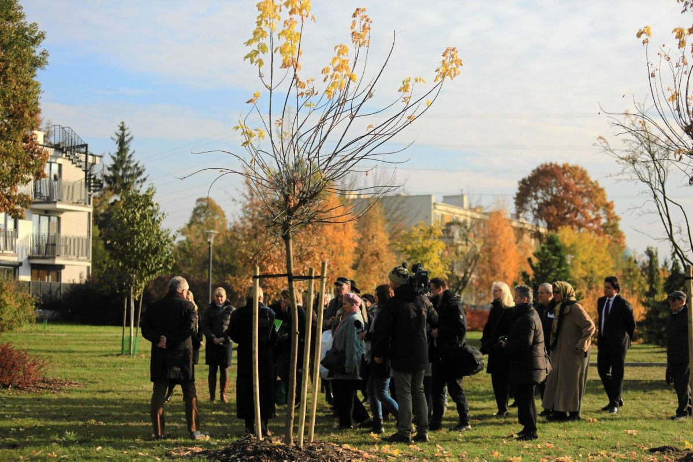
Survivors’ Park

Slide 23
I feel a bitter-sweet sense of gratification at the thought that at least some of Simkha- Bunim Shayevitch’s work has survived; that there exists at least something tangible and verifiable to support my praise of him, something never to be altered or deleted from history. The two poems found on the pile of garbage in the ghetto made their way into print, and are thus imperishable. I am grateful to fate, which, in the guise of accident, has allowed these poems with their cri du coeur, their Jeremiah-like lament to reach us from “the other side,” so that those who were not there might have some idea of what it meant to live in the horrific reality of the Lodz ghetto.

