Slide 1
The art of short story
Chava Rosenfarb The Greenhorn

Slide 2
Mystery and Manners: Occasional Prose (1969)
“I prefer to talk about the meaning in a story rather than the theme of a story. People talk about the theme of a story as if the theme were like the string that a sack of chicken feed is tied with. They think that if you can pick out the theme, the way you pick the right thread in the chicken-feed sack, you can rip the story open and feed the chickens. But this is not the way meaning works in fiction.
When you can state the theme of a story, when you can separate it from the story itself, then you can be sure the story is not a very good one. The meaning of a story has to be embodied in it, and has to be made concrete in it. A story is a way to say something that can’t be said any other way, and it takes every word in the story to say what the meaning is. You tell a story because a statement would be inadequate. When anybody asks what a story is about, the only proper thing is to tell him to read the story. The meaning of fiction is not abstract meaning but experienced meaning, and the purpose of making statements about the meaning of a story is only to help you experience that meaning more fully.”
— Flannery O’Connor “Writing Short Stories”

Slide 3
The Art of the Short Story, edited by Dana Gioia and R.S. Gwynn
z

Slide 4
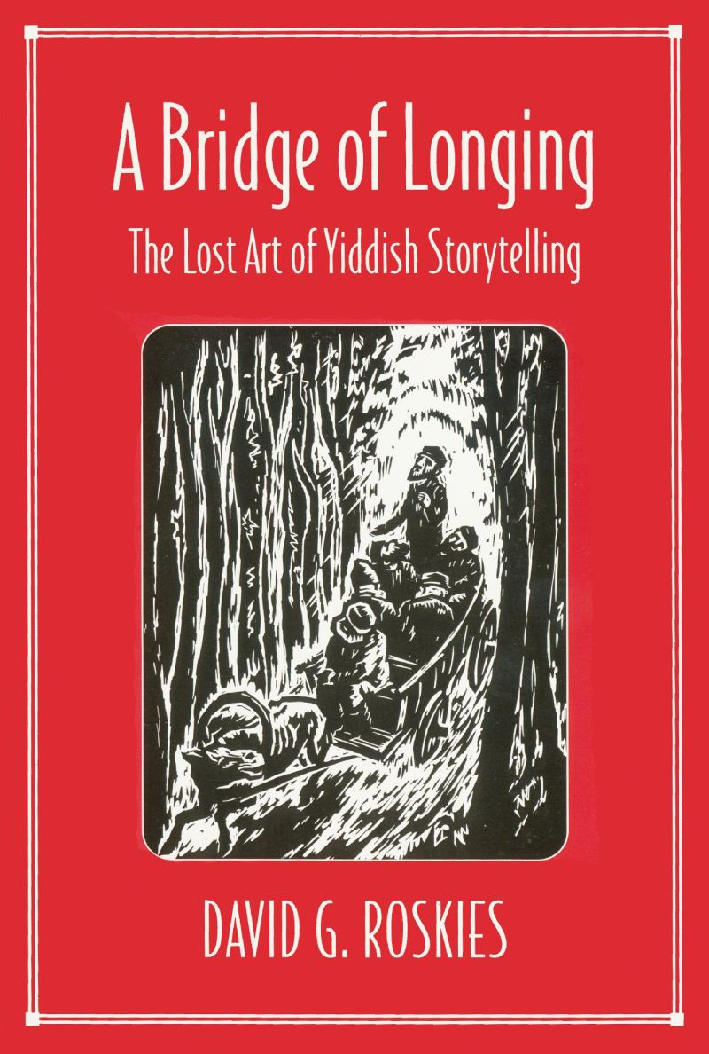
Story telling as a bridge between tradition and modernity
Tradition of education, Midrashim
Nakhman of Breslov: The Lost Princess, The Emperor and the King, The Son Who Could Not Walk, The King Who Decreed Conversion, The Humble King, The Fly and the Spider.
Yiddish literature: Mendele Mocher Sforim, Sholem Aleichem, I.L. Perez

Slide 5
דער גרינער https://www.yiddishbookcenter.org/collections/yiddish-books/spb-nybc200663/rozshanski-shemuel-kanadish-antologye-27-bilder-un-reproduktsyes-fragmentn-fun-vol-62
z

Slide 6
The Greenhorn (1950s/1974) דער גרינער
Canadian Jewish Community: Positioned as the world's fourth-largest Jewish community, Canadian Jews contribute significantly to the global diaspora
As of 2021, Canada counted about 335,000 Jews, underscoring the vibrant presence of Jewish culture and heritage within its borders.

Slide 7
Post-War Immigration:
Post-World War II, Canada embraced a more inclusive immigration policy, welcoming approximately 40,000 Holocaust survivors in the late 1940s.
This influx marked a pivotal moment in Canada's history, demonstrating its commitment to providing opportunities for those seeking to rebuild their lives.

Slide 8
The Tailor Project:
Launched in 1947 through the collaborative efforts of the Workmen's Circle and Jewish Labour Committee.
Championed by visionaries Kalmen Kaplansky and Moshe Lewis, the Tailor Project aimed to integrate Jewish refugees into Montreal's thriving needle trade.
Rebranded as the "Tailor Project," it facilitated the migration of over 2,000 displaced individuals, predominantly of Jewish descent, from war-torn Europe to Canada in 1948 and 1949, where they contributed significantly to the clothing industry.
E.g. https://www.cbc.ca/news/canada/toronto/tailor-project-event-1.5117808#:~:text=Formerly%20known%20as%20the%20%22garment,work%20in%20the%20clothing%20industry.

Slide 9
The Greenhorn
What insights are provided regarding the life of Barukh in the story? Discuss how the narrative reconstructs the protagonist's biography.
Explore the portrayal of flirting in the story and its significance. How does the narrative present the interaction of erotic energy, and what purpose does it serve?
Comment on the political landscape depicted during the break. Which political factions are introduced, and what are their affiliations?
Analyze the theme of “revolt” against humiliation in the story. Discuss the significance of terms like "freedom," the workers' reaction to mentions of trade unions, the mentioning of the old and new worlds, and the impact of the revolt.
Who or what is referred to as "the greenhorn"? Provide insight into its identity or significance within the narrative. (Greenhorn: https://en.wiktionary.org/wiki/greenhorn)

