Slide 1
Jewish Women’s Writing: re-writing the myths
Ula Chowaniec, Spetember 2021

Slide 2
Unrelated Annoucements:
Beit Toratah
https://www.beittoratah.org/about
Limmud!
https://limmud.se/na-speakers/emma-augustsson/

Slide 3
Burning Girls and Other Stories (2021)
Veronica Schanoes is an American author of fantasy stories and an associate professor in the department of English at Queens College, CUNY. Her novella Burning Girls was nominated for the Nebula Award and the World Fantasy Award and won the Shirley Jackson Award for Best Novella in 2013. She lives in New York City. Burning Girls and Other Stories is her debut collection
Talk: https://www.youtube.com/watch?v=flhGbksawGQ

Slide 4
The Myth of Lilith
The Myth of Lilith
Midrashim:
"The angels who are in charge of healing are Sanoy, Sansenoy and Semangelof. While God created Adam, who was alone, He said, 'It is not good for man to be alone' (Genesis 2:18). He also created a woman, from the earth, as He had created Adam himself, and called her Lilith. Adam and Lilith immediately began to fight. She said, 'I will not lie below,' and he said, 'I will not lie beneath you, but only on top. For you are fit only to be in the bottom position, while I am to be the superior one.' Lilith responded, 'We are equal to each other inasmuch as we were both created from the earth.' But they would not listen to one another. When Lilith saw this, she pronounced the Ineffable Name and flew away into the air. Adam stood in prayer before his Creator: 'Sovereign of the universe!' he said, 'the woman you gave me has run away.' At once, the Holy One, blessed be He, sent these three angels to bring her back."Said the Holy One to Adam, 'If she agrees to come back, what is made is good. If not, she must permit one hundred of her children to die every day.' The angels left God and pursued Lilith, whom they overtook in the midst of the sea, in the mighty waters wherein the Egyptians were destined to drown. They told her God's word, but she did not wish to return. The angels said, 'We shall drown you in the sea.'"'Leave me!' she said. 'I was created only to cause sickness to infants. If the infant is male, I have dominion over him for eight days after his birth, and if female, for twenty days.' "When the angels heard Lilith's words, they insisted she go back. But she swore to them by the name of the living and eternal God: 'Whenever I see you or your names or your forms in an amulet, I will have no power over that infant.' She also agreed to have one hundred of her children die every day. Accordingly, every day one hundred demons perish, and for the same reason, we write the angels names on the amulets of young children. When Lilith sees their names, she remembers her oath, and the child recovers."
Lilith (/ˈlɪlɪθ/; Hebrew: לִילִית‎, romanized: Līlīṯ) is a demonic figure in Judaic mythology, supposedly the primordial she-demon and alternatively first wife of Adam.

Slide 5
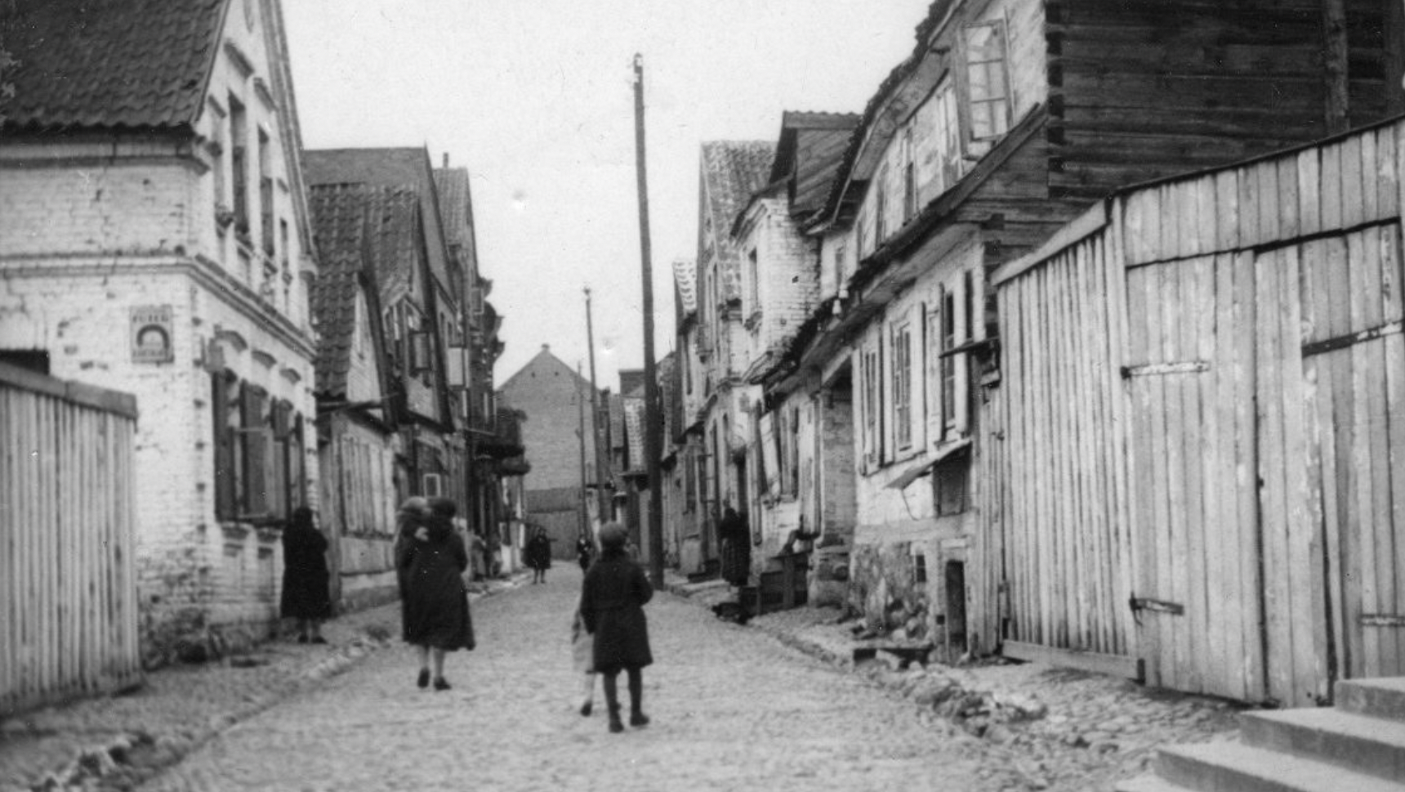
Re-claiming the narratives
Białystok/ Jewish Białystok

Slide 6
The overwhelming feeling of loss
Białystok Jewish Quarter
Countryside and Jewish Community

Slide 7
Revolutionary women
The beginning of the novel

Slide 8
Discussion
Choose ONE character /themes/ one scene/ a conversation from the story and discuss its:
Function in the story buidling
Emotional aspect
Historical background/connections
Reflections, other interpretation?

Slide 9
Next: Who is Emma Goldman?
Short story by Veronica Schanoes and
The novel by Vivian Gornick Emma Goldman: Revolution as a Ways of Life
Emma Goldman texts on women’s emancipation

Slide 10
The Revolutionary America….
Eve Adams was a rebel. Born Chawa Zloczewer into a Jewish family in Poland, Adams emigrated to the United States in 1912. The young woman befriended anarchists, sold radical publications, took a new name, and ran lesbian-and-gay-friendly speakeasies in Chicago and New York. Then, in 1925, Adams risked all to write and publish a book titled Lesbian Love.

