Slide 1
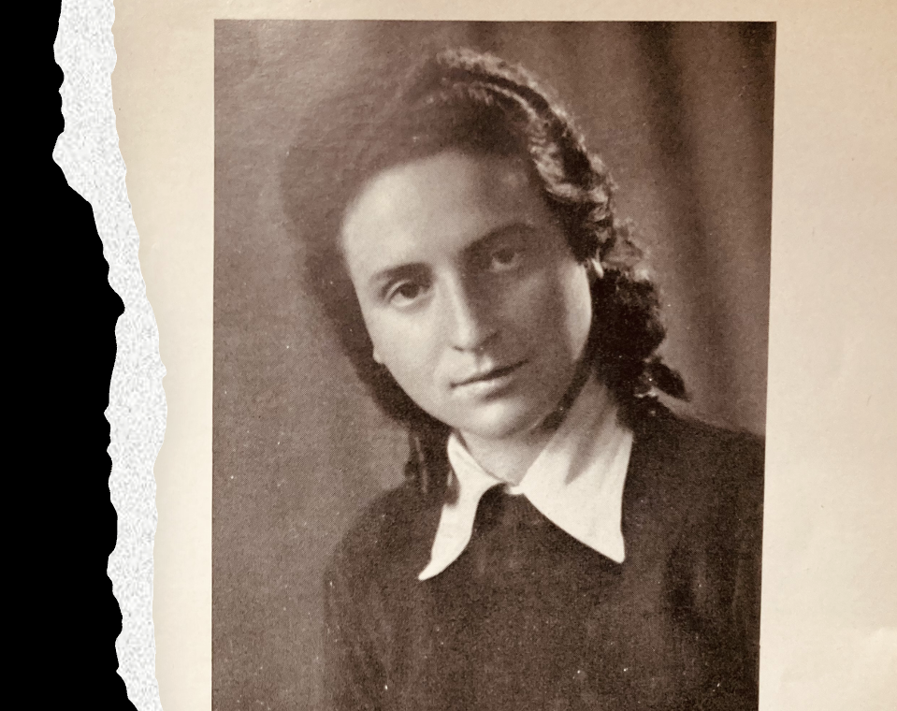
Chava Rosenfarb The Art of Short Story
Ula Chowaniec
Jan Schwarz
Paideia, Spring 2024

Slide 2
Syllabus:
(7/3) - Chava Rosenfarb writing/ Confessions. Introduction. (Jan and Ula)
(14/3) – Chava and the Yiddish Literary Tradition. (Jan)
(21/3) Chava’s Art of Storytelling and the Yiddish Women Writers. (Ula)
(28/3) - Last Love. The Memory of the Khurbn (Ula)
(11/4) – Chava and Other Polish Yiddish Writers (Jan)
(18/4) - Zenia/Chava Correspondence. Introduction to Edgia’s Revenge (Ula)
(25/4) - Jan. Edgia’s Revenge. The startling story of a woman kapo. (Jan)
8. (2/5) - Letters to God// El Khanun Kadia Molodowski (Jan)
9. (16/5) – Yiddish and Translation? Chava on Translation (Ula)
10. (30/5) - Overview, feedback, and our favorite texts (Ula and Jan)
Syllabus:
https://docs.google.com/document/d/1AZzwoFPay-ctCd8qO-uHdXwfgZyf8EWR0CSpRGkpgkc/edit
Reading materials:
https://drive.google.com/drive/folders/1fP24M3rs0raXupu6qz_c3MwwtraPXR8J?usp=sharing

Slide 3
Meetings: short stories and essays
Introduction to short stories
Plan for discussions
Break-out rooms
Plenary discussion
We encourage presentations

Slide 4
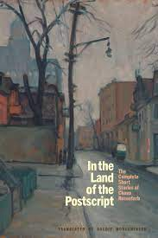
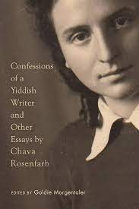
Literature:
Land of the Postscript. The Completed Short Stories of Chava Rosenfarb (2023)
Confessions of a Yiddish Writer and Other Essays (2019)
Paideia Chava Rosenfarb 1
4

Slide 5
Goldie Morgentaler
https://www.youtube.com/watch?v=PL_EkIOpaQU

Slide 6
Our class

Slide 7
Introduction: few biographical information & Yiddish literary contexts

Slide 8
די באַלאַדע פֿון נעכטיקן װאַלד ד Di ballade fun nekhtikn vald
װער װעט זײ בעסער פארשטײן, די לידער מײנע, װי דו, זשעניאַ?
Who will understand them - these poems of mine - better than you, Zenia?

Slide 9
The Ballad from the Yesterday’s Forest

Slide 10
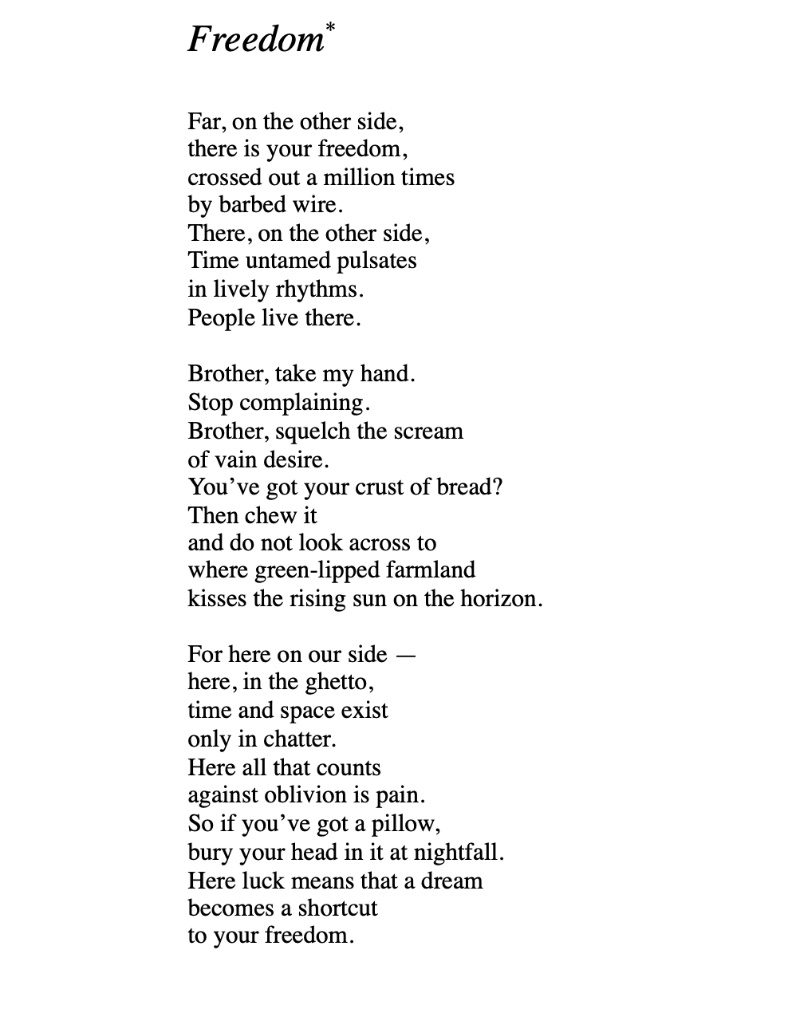

Slide 11
חוה ראָזענפֿאַרב
Chava Rosenfarb (1923-2011)
Born into a Bundist family in Lodz, she embraced her heritage by attending a Bundist Yiddish primary school followed by a Jewish-Polish secondary school.
At 17, she was forced to relocate to the Lodz ghetto, where she demonstrated resilience and fortitude.
Surviving the horrors of the ghetto, she and her family were transported to Auschwitz in 1944, enduring further trials in Sasel and Bergen-Belsen until liberation.
Tragically, her father, Abram, perished just before the war's end in a train bombed by Allied planes.

Slide 12
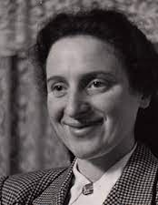
חוה ראָזענפֿאַרב
After enduring years of being „stateless and homeless” in Europe, she, alongside her mother and sister, found a new home in Montreal in 1950.
Married to Henry Morgentaler (though they divorced in 1975), she built a family, raising a daughter and a son.
Her daughter, Goldie Morgentaler, now a professor of English literature at the University of Lethbridge, has made significant contributions by translating „The Tree of Life” and many of her mother’s literary works into English.

Slide 13
Publications: https://chavarosenfarb.com/books
Di balade fun nekhtikn vald / The ballad of yesterday's forest, London, 1947
Dos lid fun yidishn kelner Abram / The song of the Jewish waiter Abram
Geto un andere lider / Ghetto and other poem
Aroys fun gan-eydn / Out of Paradise
Der foigl fun geto / The Bird of the Ghetto, 1966
Der boim fun lebn / The Tree of Life, 1972
Paideia Chava Rosenfarb 1
13

Slide 14
Chava and the Yiddish Literary Scene

Slide 16
Excerpts for discussion?
What type of writer was Chava Rosenfarb?
How does Chava Rosenfarb depict the experience of the ghetto in her writing?
What was Chava Rosenfarb’s approach to writing after the Holocaust?
How does Chava Rosenfarb describe her experience of writing after the Holocaust?
What is the significance of Holocaust literature for post-war generations?

Slide 17
A Yiddish Women Writer: Confession of a Yiddish Writer
Confessions of a Yiddish Writer
I was never a Sunday scribbler. Writing was never a hobby for me, a pastime to while away the hours. On the contrary, it was as necessary to me as life itself; it was a refuge, a substitute for living, a confrontation with myself, a form of confession—but always it was a necessity that allowed me to feel that my life had an accompanying motif, an underlying melody. Writing often gave me moments of such ecstasy as can only be experienced by lovers; it gave me instances of such intense spiritual forgetfulness that I truly believed that I and the cosmos were one, so that through the simple act of breathing the air in my room I felt that I was inhaling the universe itself. Clasped within the bosom of this universe, my physical self simply ceased to be. Rare moments these, but blessed. p. 24

Slide 18
Ghetto
In the ghetto, we lived in constant terror that the Germans would deport us to the death camps, especially to Auschwitz, which was the closest camp to Lodz. These deportations occurred continually from the time the Lodz ghetto was first established in 1940 until its liquidation in 1944. The deportations decimated the ghetto population, until, of the 203,000 Jews who were originally forced to live behind the barbed wire fence, only 68,000 remained. At the end of the summer of 1944, the Lodz ghetto was liquidated. We—that is, my parents, my sister and I—tried to avoid being sent on the transports that were emptying the ghetto. So, along with a group of about ten of our nearest and dearest friends, we hid in the back room of our two-room Baluty apartment, disguising the existence of this room by placing a large wardrobe in front of the entrance. We managed to fool the Germans for only two days. On the 28th of August we were discovered and transported to Auschwitz. p. 27

Slide 19
Writing after the Holocaust
From time to time the thought of writing a book again entered my mind. The need to write and make order in the chaos raging within me was great. Yet the fear of writing, of again plunging into the abyss of terror was greater still. More than once, I was ready to take pencil in hand, and more than once I decided never to touch upon the subject of the ghetto and the camps. I doubted whether it was at all possible to impose a form, a discipline on the painful phantasmagoria whirling inside me. The more strongly I felt the urge to write, the weaker I felt in the face of the enormity of the subject. I feared it, and this fear hovers over me to this day, whenever I try to write on the subject of the Holocaust. p. 29

Slide 20
The role of Holocaust literature:
I wrote The Tree of Life in the hope that I might bring the next generations a little closer to the awareness of what it means to have survived the Holocaust. I bore witness in the belief that there is no future for mankind if it refuses to face itself in the mirror of the Holocaust, disturbing and horrifying though that mirror might be. It is a mirror that tells us that man is not the most beautiful and noble of God’s creatures, but the most tragic. It tells us that man’s potential for aggression and evil, for hating others and for self-hatred, for committing suicide through acts of homicide and genocide may lead to his own eradication from the face of the earth. Moreover, if we forget the Holocaust, we deprive ourselves of the knowledge of the human soul, with its hidden recesses of love and care, of dignity and courage, for those were in fact the qualities which the humiliated, spat upon, doomed Jews displayed every day of the tortured lives they led between the barbed wire fences of the ghetto. (p. 43)

